Slide 1
Abrasive Machining

Slide 2

Watch Video Here

Slide 3
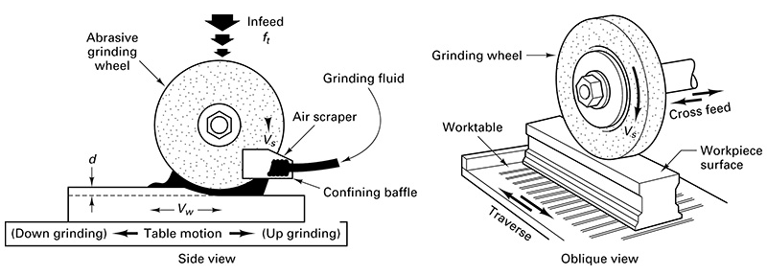
Surface Grinding

Slide 4

Watch Video Here
Notes:
Abrasives

Slide 5
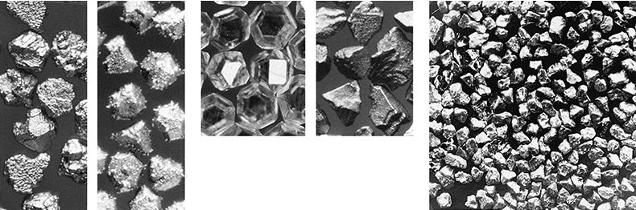
Loose Abrasive Grains Irregular Cutting Edges

Slide 6
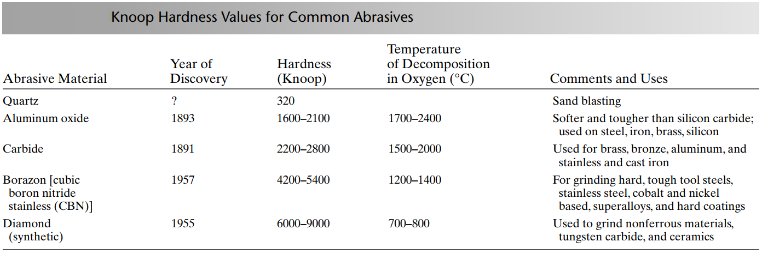
Knoop Hardness of Grits

Slide 7
Abrasive Grain Size and Geometry

Slide 8
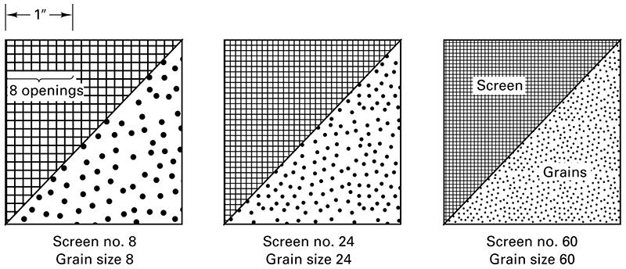
Typical Screens for Sorting Abrasives

Slide 9
Grain Sizes
Coarse – 4-24
Medium – 30-60
Fine – 70-600

Slide 10
Common Grit Sizes
Aluminum oxide 4 – 240 grit
Silicon carbide 2 – 240 grit
Diamond and CBN 120 – 400 grit
Lapping/fine honing (flour sizes) 240 – 600 grit

Slide 11
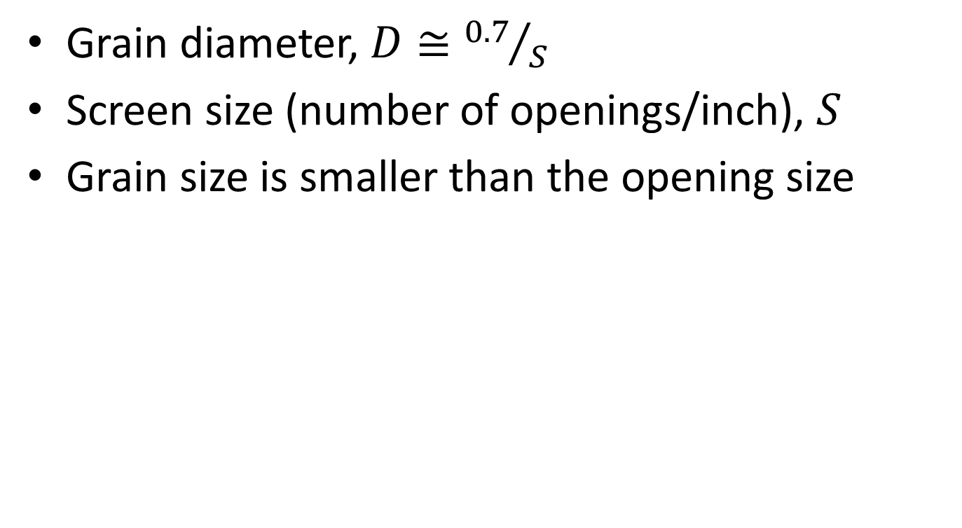
Grain Diameter vs. Openings
Grain diameter, $D≅{0.7}/S$
Screen size (number of openings/inch), $S$
Grain size is smaller than the opening size

Slide 12
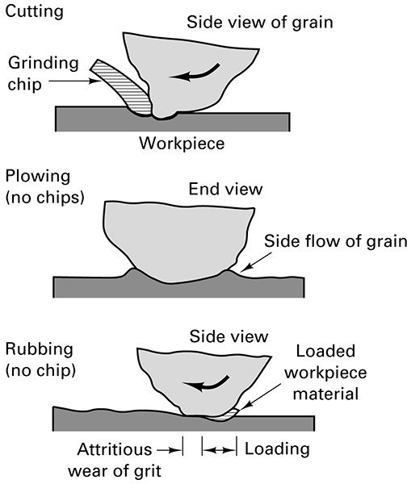
Grits Interact: Cutting, Plowing, Rubbing

Slide 13
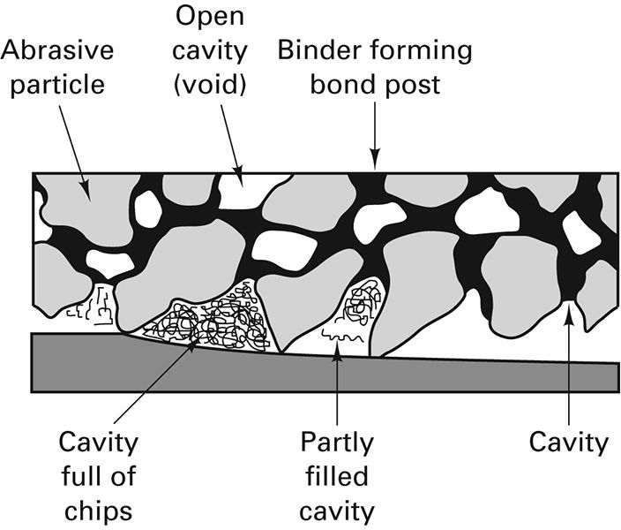
Voids between grains collect chips

Slide 14
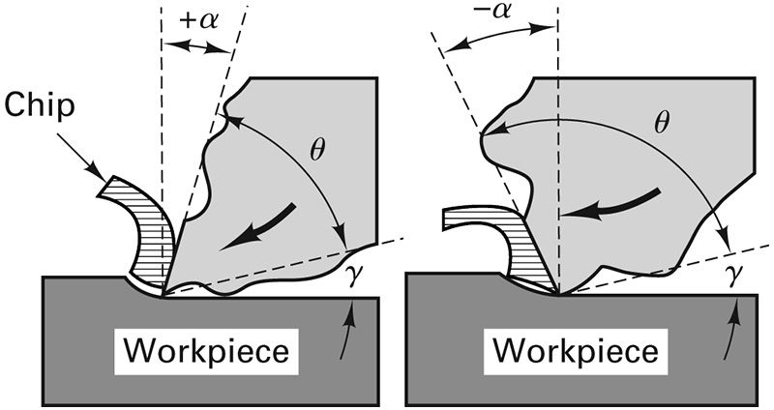
Positive or Negative Rake Angle

Slide 15
Heat Transfer in Abrasive Machining
Plowing and Rubbing: energy goes into workpiece
Cutting: 95 – 98% of energy (heat) goes into chips to makes sparks – chips burn

Slide 16
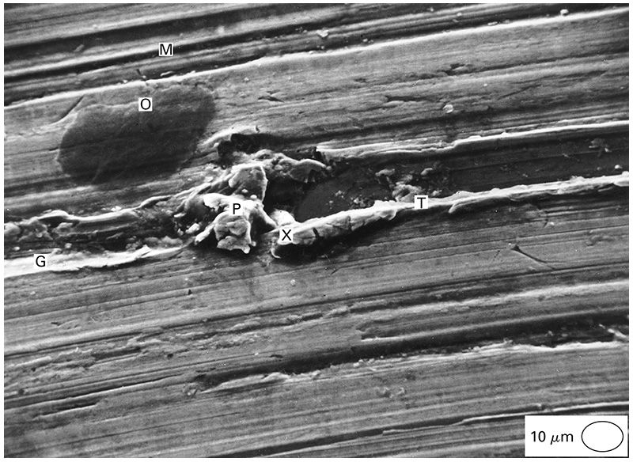
SEM Micrograph of Ground Steel Surface
G – Fractured grit groove
M – Machined track
O – Oil deposit
P – Prow formation
T – Plowed track
X – Fractured grit

Slide 17
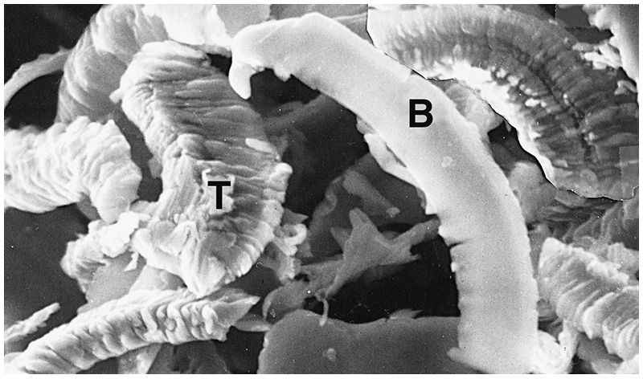
SEM Micrograph of Stainless-Steel Chips
T – Top of chip
B – Bottom of chip

Slide 18
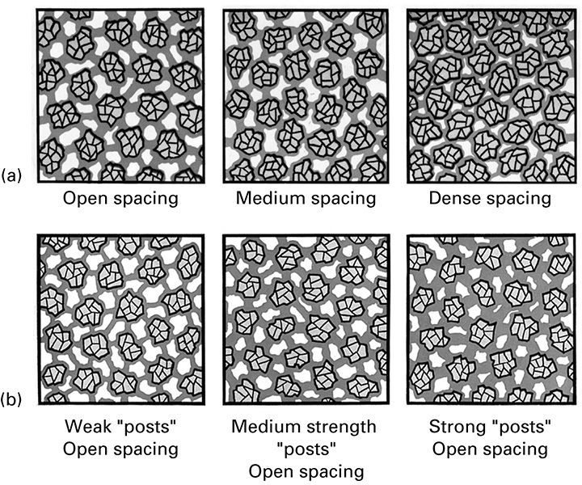
Wheel Structure and Grade

Slide 19
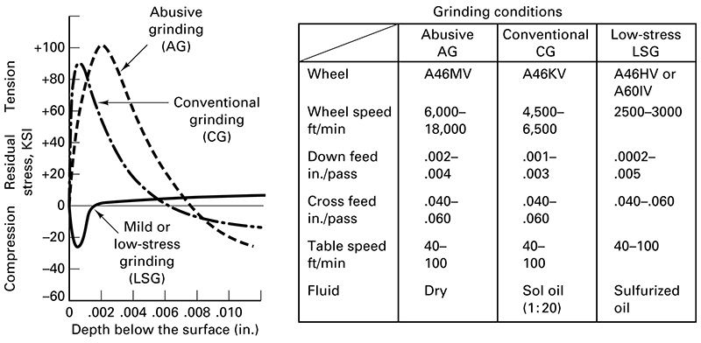
Residual Stress Distributions

Slide 20
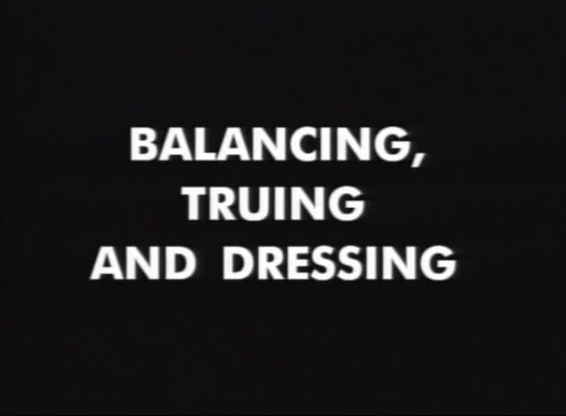
Watch Video Here

Slide 21
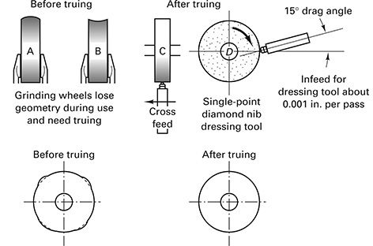
Truing a Wheel

Slide 22
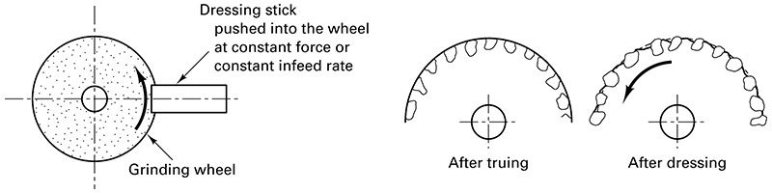
Stick Dressing vs. Truing

Slide 23
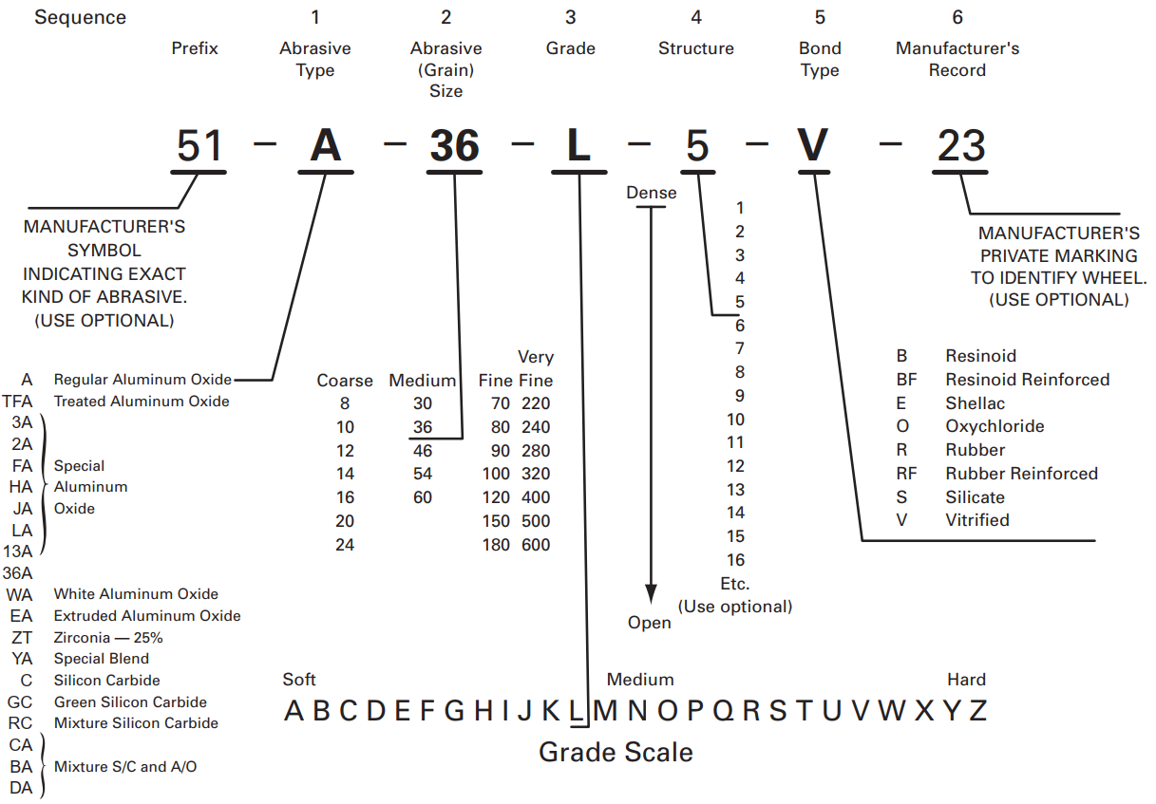
Standard Markings for Grinding Wheels

Slide 24
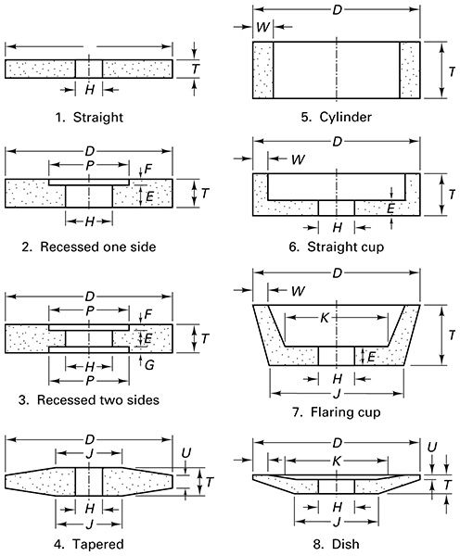
Standard Grinding Wheel Geometry

Slide 25
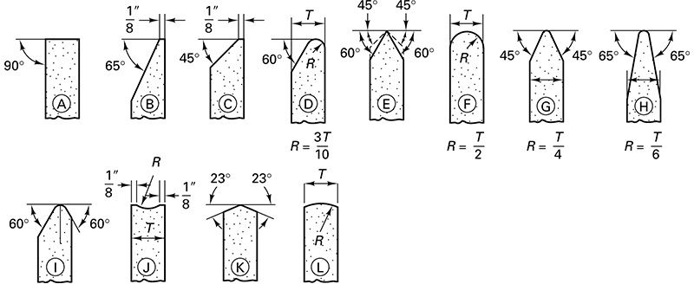
Standard Face Contours

Slide 26

Watch Video Here

Slide 27
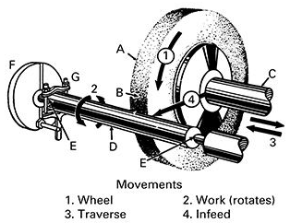
Cylindrical Grinding Between Centers

Slide 28
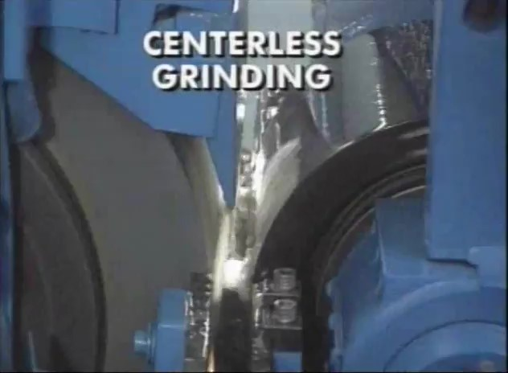
Watch Video Here

Slide 29
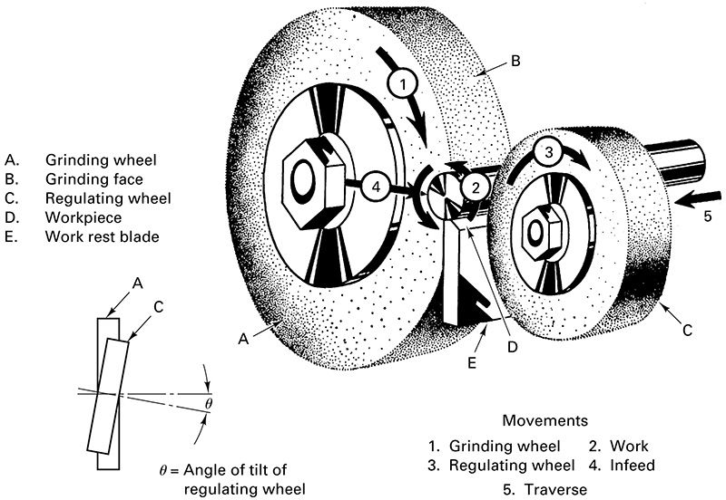
Centerless Grinding

Slide 30
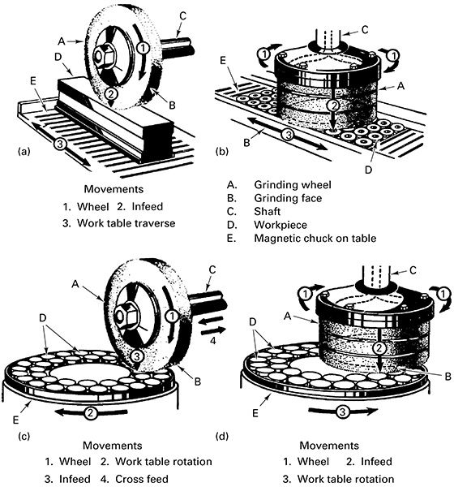
Surface Grinding

Slide 31
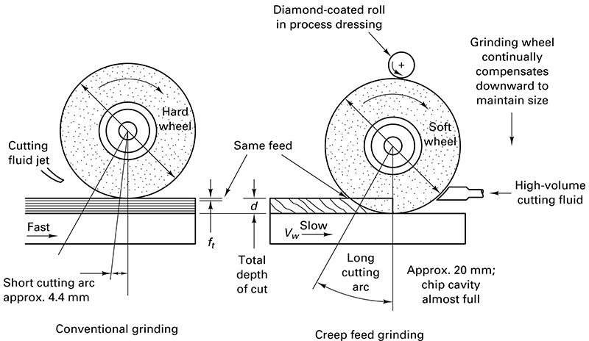
Creep-feed Grinding

Slide 32
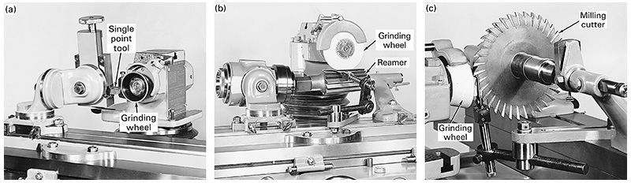
Tool Grinding

Slide 33
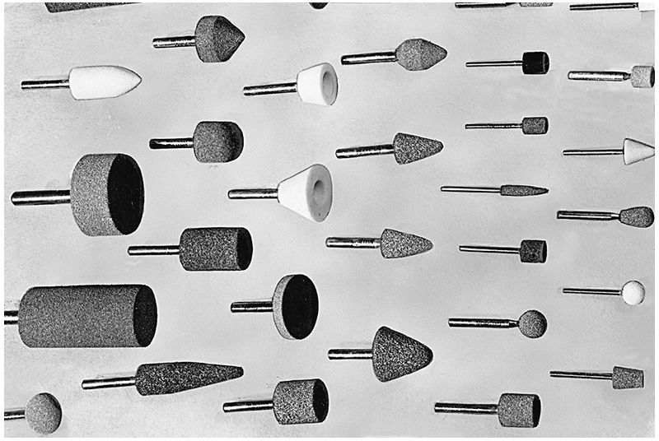
Hand-held Grinding Wheels

Slide 34
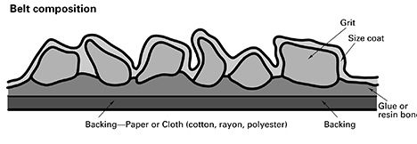
Coated Abrasive Belt Composition

Slide 35
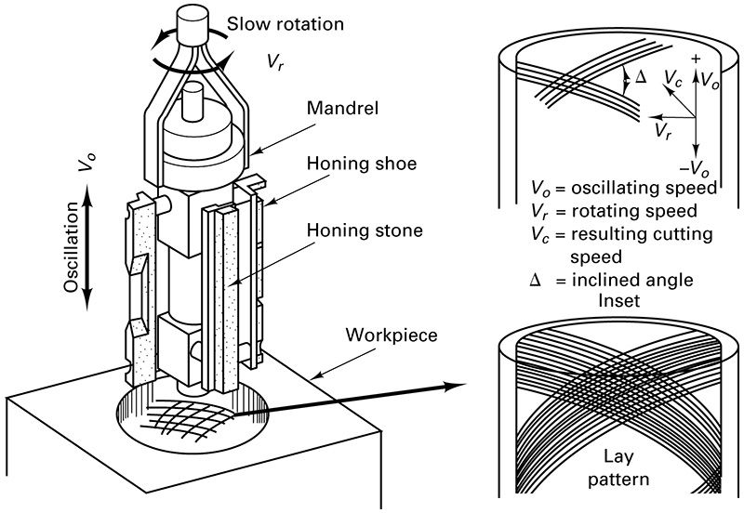
Honing

Slide 36
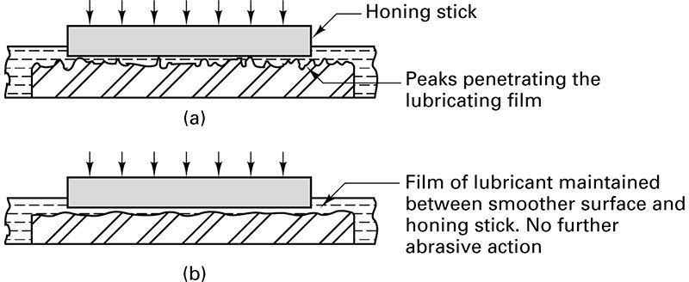
Superfinishing

Slide 37
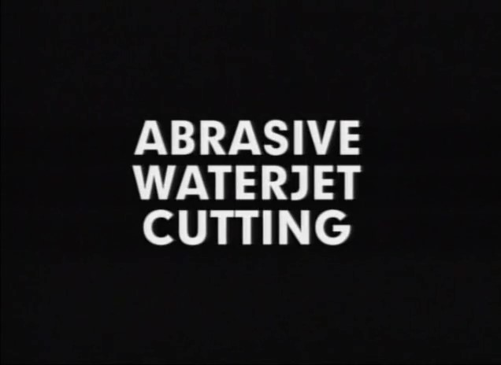
Watch Video Here

Slide 38
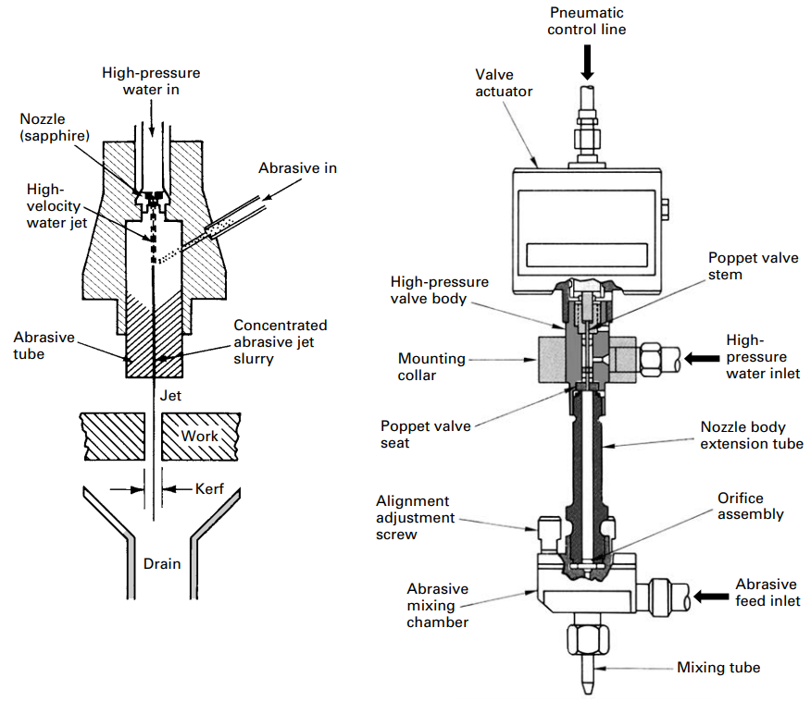
Abrasive Waterjet Machining

Slide 39
Materials cut by AWC
Plastics
Glass
Ceramics
Rubber
Metals
Composites
Any material thru choice of abrasives

